Slide 1
Horizon Runner
The Shoot Em Up Game with Affective Adaptation

Slide 2

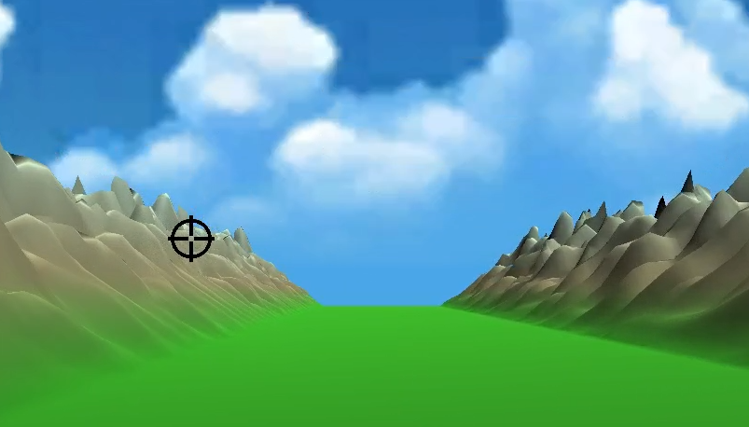
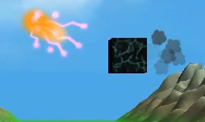

Basic Idea
Infinitely scrolling railshooter
Adaptive difficulty
Randomized obstacles
High Score Based

Slide 3
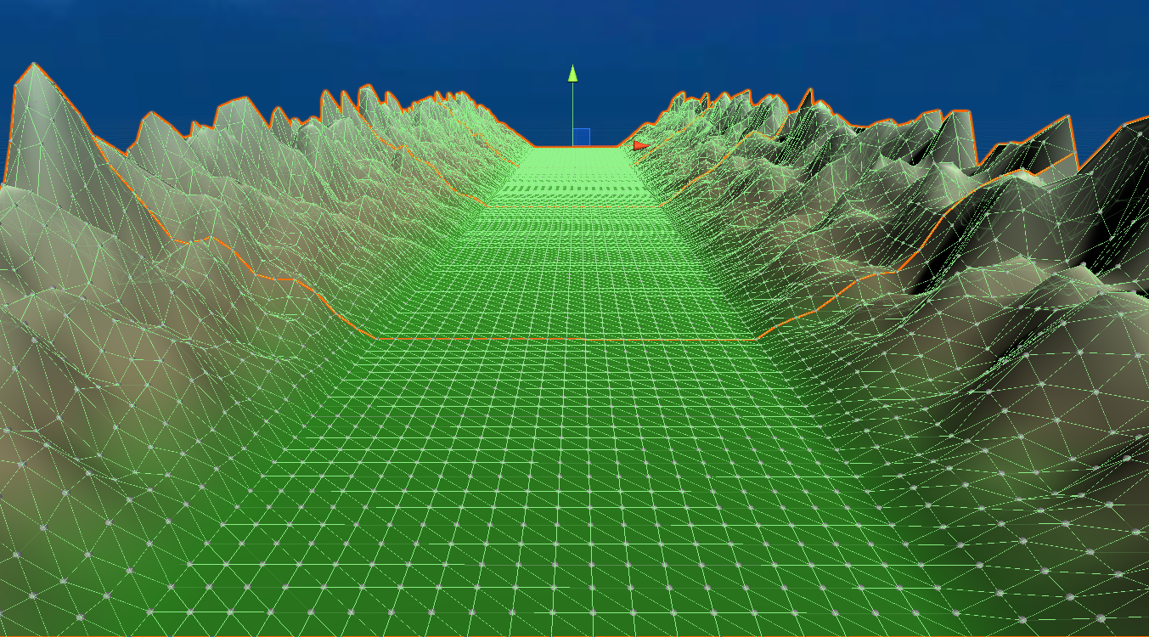

The Terrain
Procedural
Mesh grid
Broken down to chunks
Perlin Noise for hills
2D view of perlin noise

Slide 4
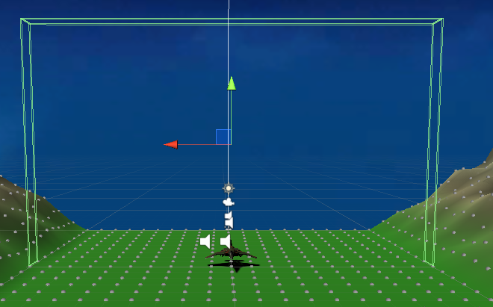
The Player Controls
Automatic “forward” movement
User controlled altitude and longitude

Slide 5
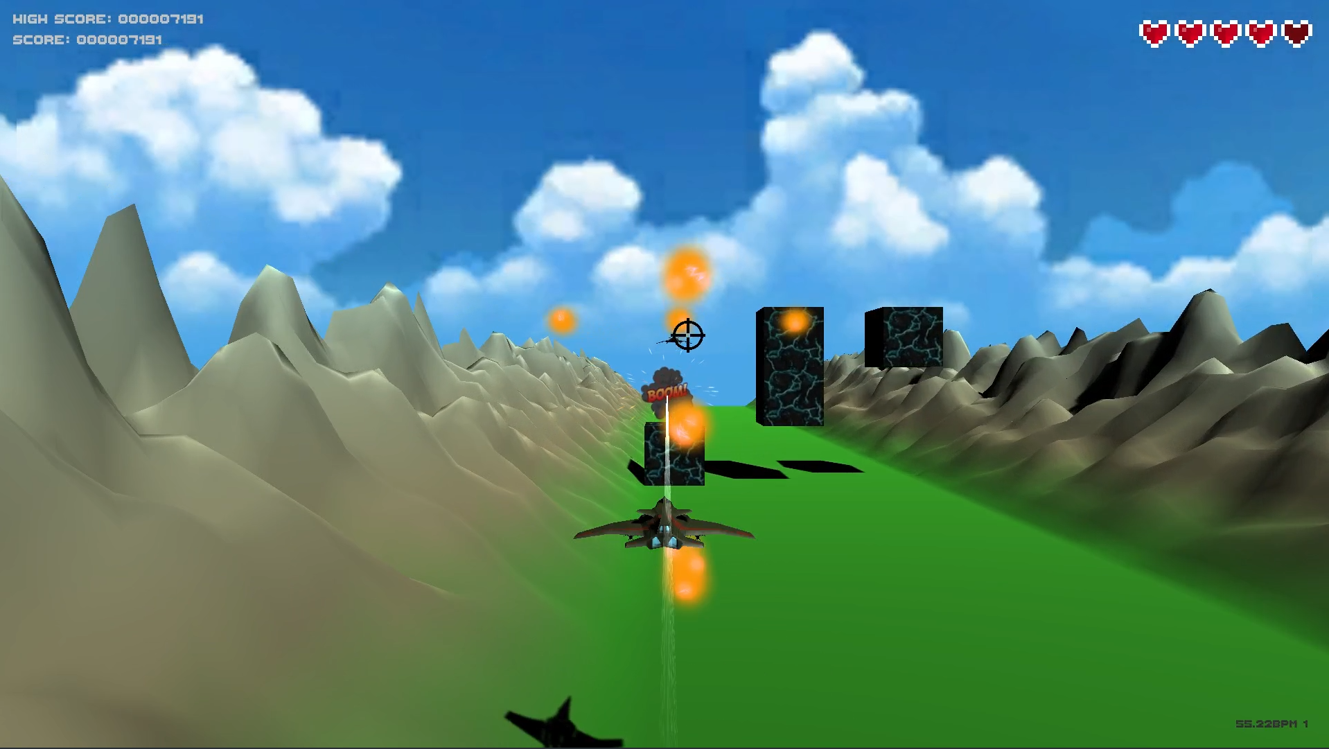
The Player Controls

Slide 6
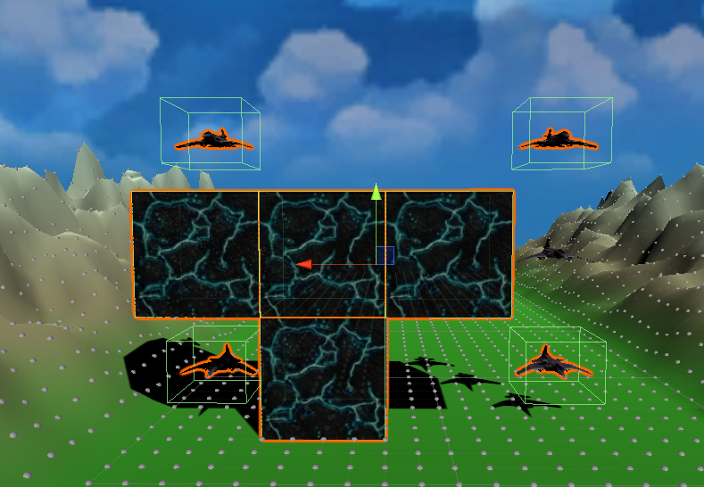
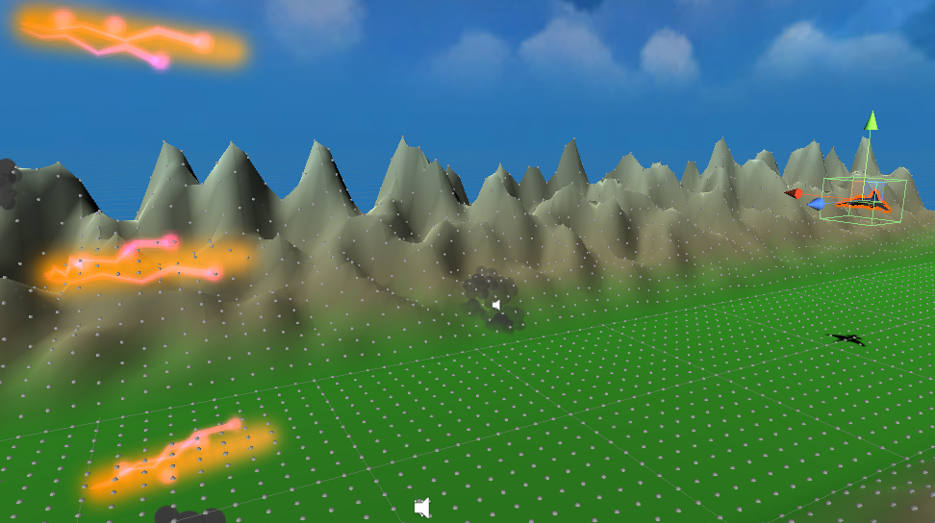
The Obstacles and Enemies
Spawned randomly
Amount depends from difficulty
Obstacles are indestructible
Enemies shoot projectiles
Vertical projectile set

Slide 7
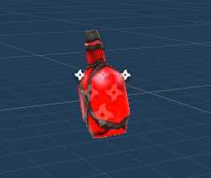

Fail Condition: Lives
No more lives → Game Over
Potions give 2 extra lives

Slide 8
Difficulty Adaptation
Done in two selectible ways:
Player performance (based on life counter)
Heart rate (using machine learning to detect it)

Slide 9
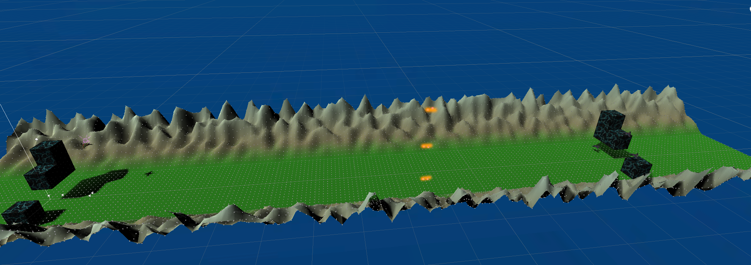
Difficulty: What Changes?
Scroll speed
projectile speed
Obstacle frequency

Slide 10
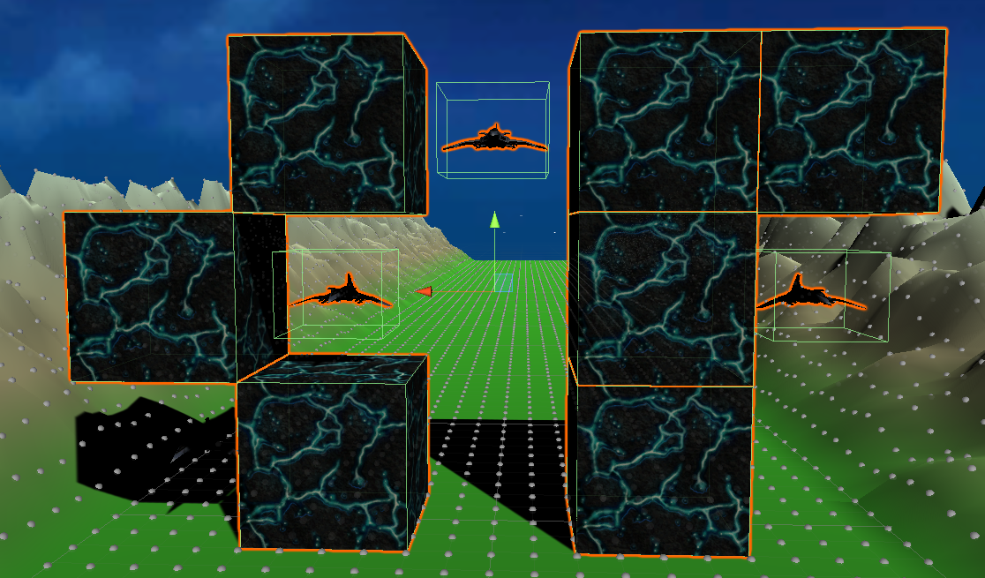
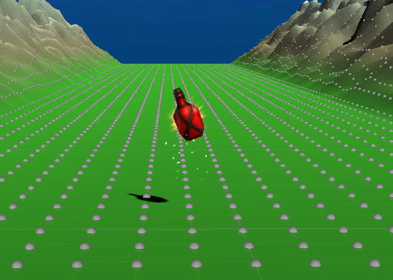
Difficulty: What Changes?
Obstacle and Enemy number per wave
Health pickup spawn frequency

Slide 11
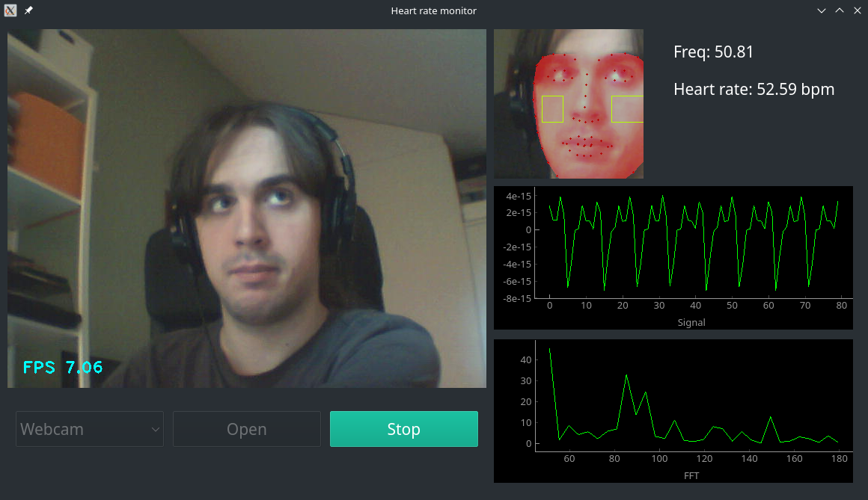
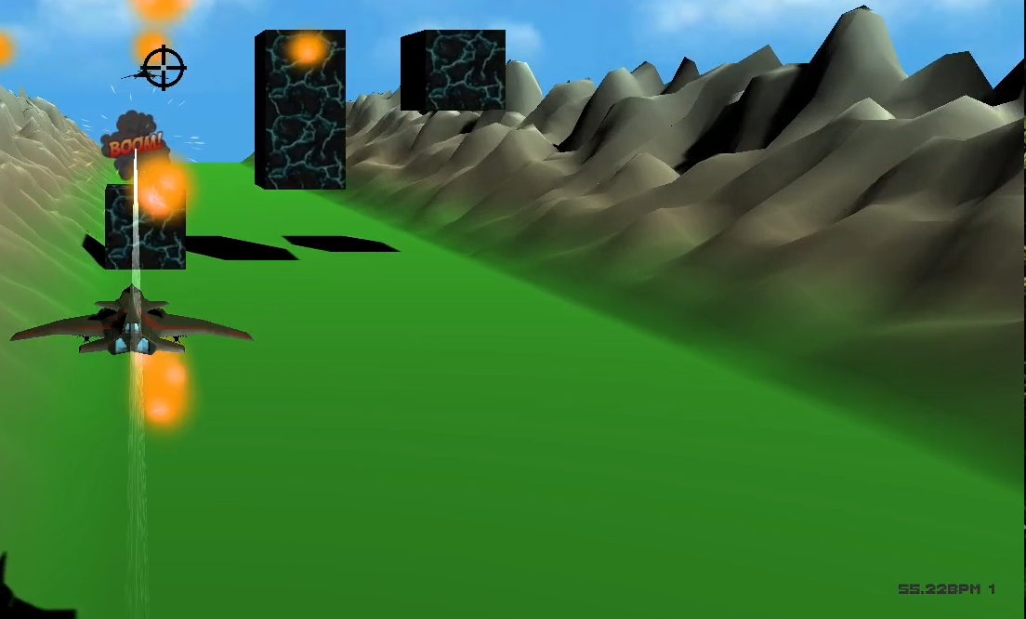
Heart Rate Detection
Trained model in python
Unity game
ZMQ

Slide 12
Heart Rate Detection - Issues
Python app’s performance heavily depends from the camera’s quality
If camera FPS falls below 6FPS, it crashes (this happens when the camera sets a too high exposure time)
The reported BPM varies too wildly sometimes
Hard to satisfy prerequisites (dbus, numpy, ...)

Slide 13

Heart Rate Detection - Difficulty
Increase Difficulty
Decrease Difficulty
~=
No Change in Difficulty

Slide 14
Player Performance
Increase difficulty when player has high health for a sufficent amount of time
Maximamlise difficulty based on remaining lives

Slide 15
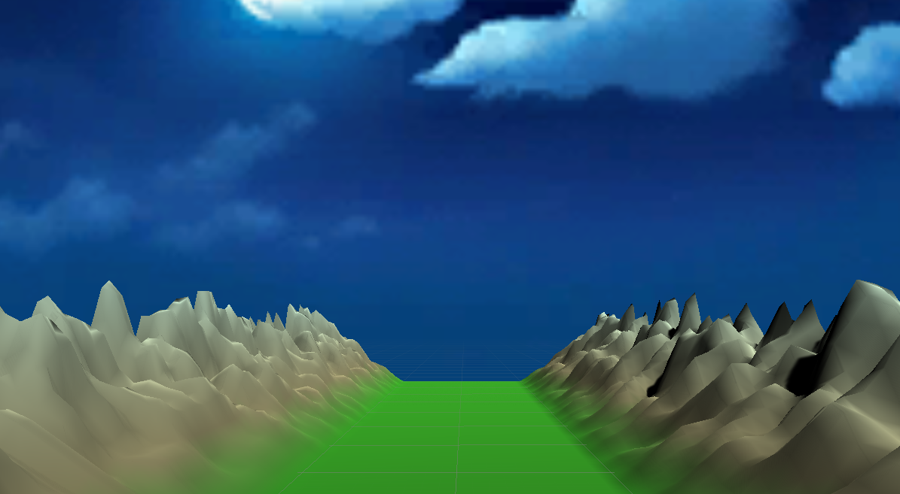
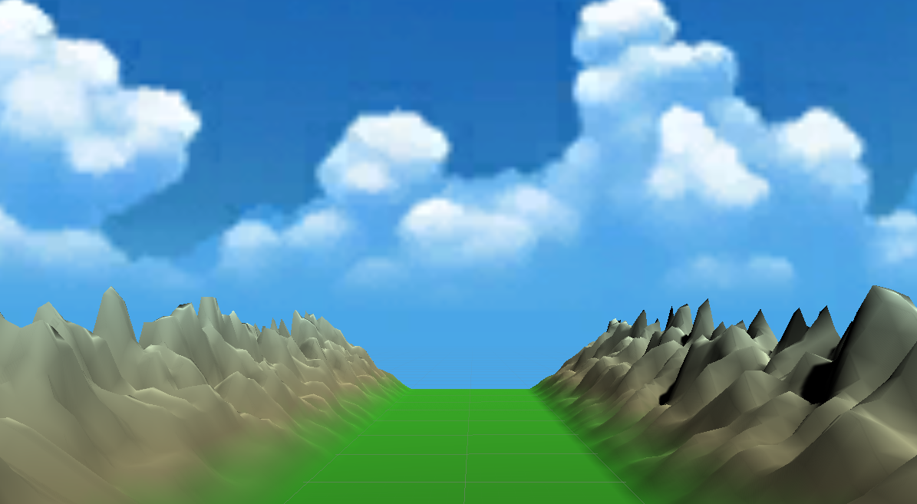
Mood affectation - Sky
When difficulty high → Night
When difficulty low → Day

Slide 16
Mood affectation - Music
Intense music when low on health
Calm/uplifting music otherwise

Slide 17
[Screencasts]

Slide 18
Thank You for Your Attention!

